Slide 1


CV BALLOT PAPER
(Progress Presentation)
2020-05-21

Slide 2

CURRENT STATUS
Initial exploration of dataset (Done)
Data preprocessing and Augmentation (Done)
Baseline model selection (Done)
Initial result analysis (Done)
Trying out other model and analysis(Done)
Future works(In Progress/Suggested)
7446 rows

Slide 3
Dataset Description
Dataset
Ballot paper Images - 420 x 618(Resolution), 3 color channel(RBG)
Train Set - 9600 images (80%)
Test Set - 2609 images (20%)
Target Labels - 48 labels (0-47)
Problem - Multiclass Image classification

Slide 4
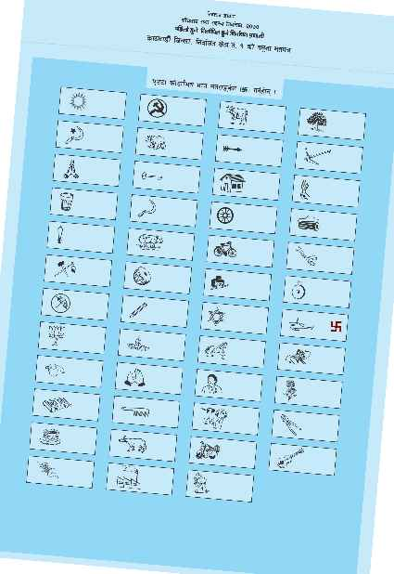
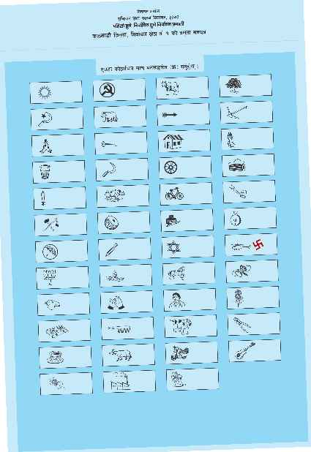
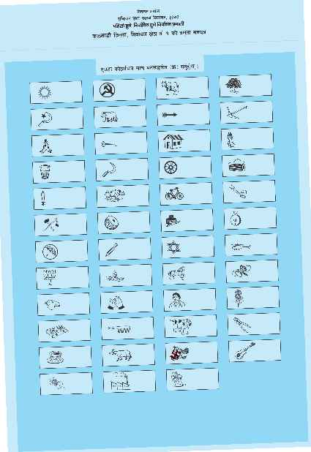
Dataset Visualization
Random Samples of label (1-47)
Notes:
These images have the selection symbol (swastika) within the bounding boxes.

Slide 5
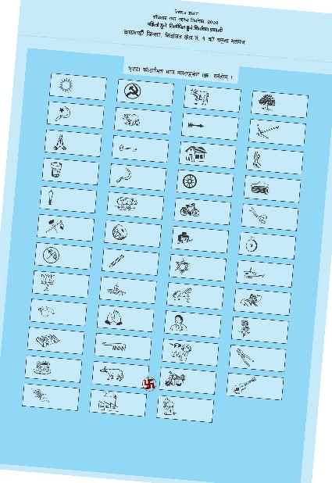
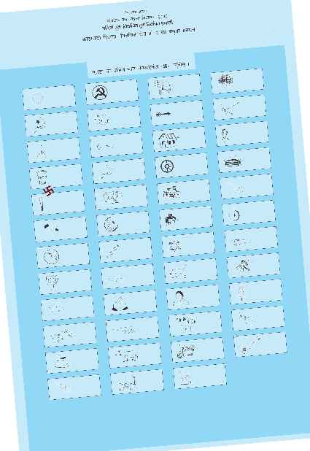
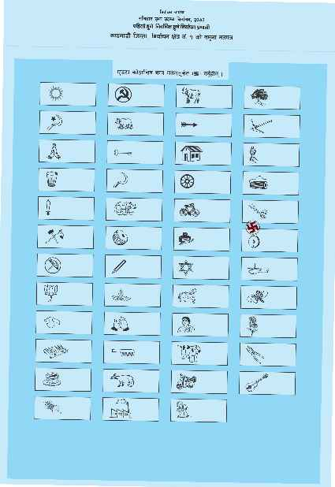
Dataset Visualization
Random Samples of label (0)
Notes:
Selection symbol outside bounding boxes and can occur randomly, Also removal of noise is essential(see the quallity of images differs)

Slide 6
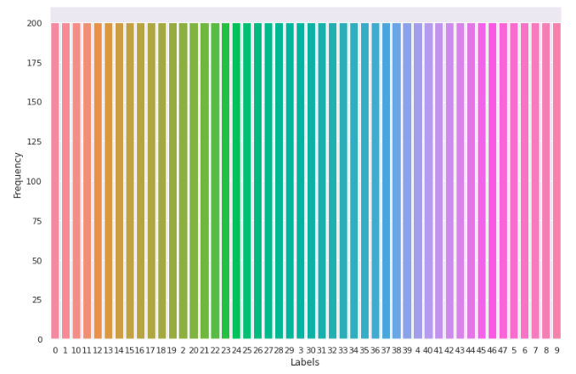
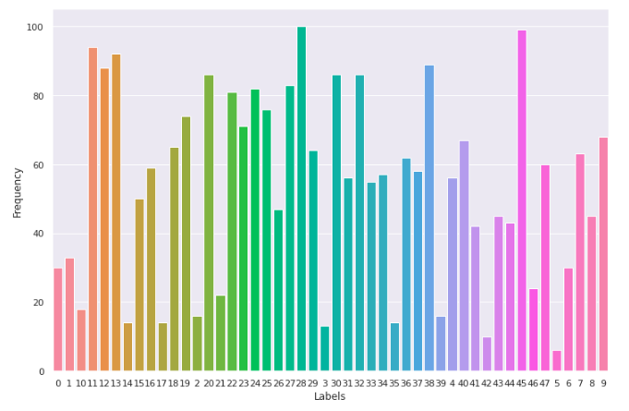
Dataset Visualization
Train set target label counts
Test set target label counts
Notes:
Accuracy is a bad metric for test set.

Slide 7
Dataset Loading
Dataset - Each image array - 420 x 618 x 3
- Whole dataset - 420 x 618 x 3 x 12209 (Very large memory)
Keras API’s ImageDataGenerator class for loading dataset in batch (using dataset and directory)
Batch upload of data with various real time augmentation and preprocessing. (lower load on memory)
Notes:
Unable to load dataset at once, Instead used Keras’s ImageDataGenerator class.

Slide 8
Dataset Augmentation and Preprocessing
Augmentation
Shear Transformation
shear_range: 0.2 (Range of shear angle)
Zooming
Zoom_range: 0.2 (Range of zoom, [1-0.2, 1+0.2])
Preprocessing
Magnitude Normalization - Pixel value - [-1,1]
Change in Resolution - 150 x 150

Slide 9
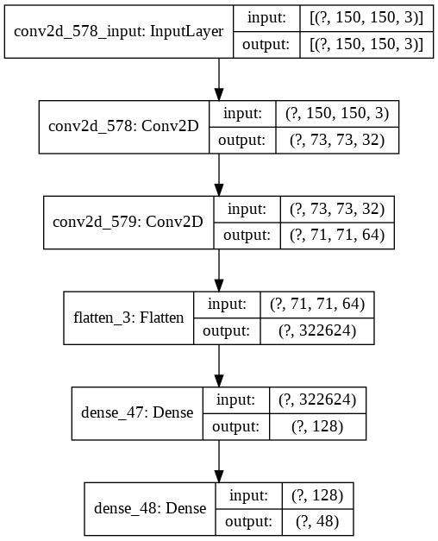
Baseline Model
Simple CNN
Simple CNN model Graph

Slide 10
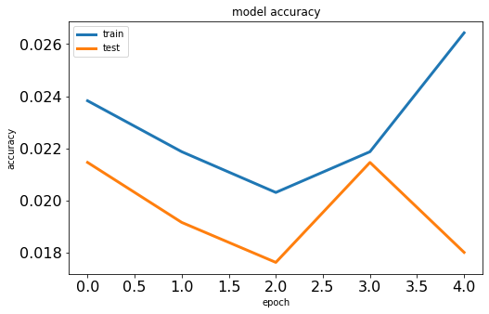
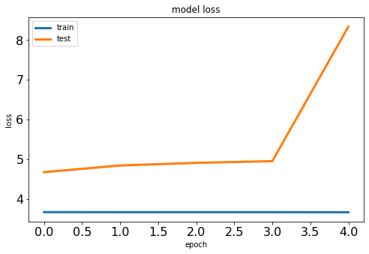
Baseline Model
Simple CNN
Accuracy and Loss(Categorical Cross-Entropy)

Slide 11
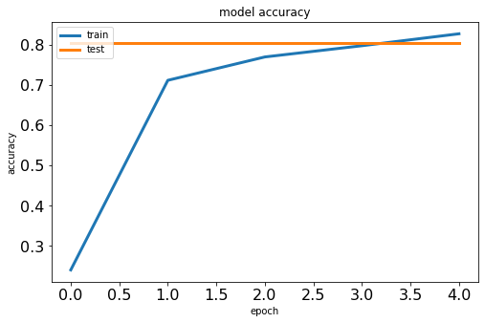
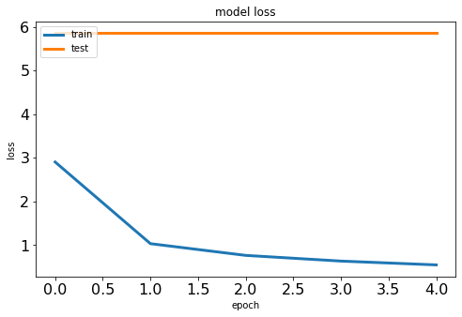
Improvement on Model architecture
Modified CNN
Accuracy and Loss(Categorical Cross-Entropy)
Additional layer results in more time for training but higher accuracy.

Slide 12
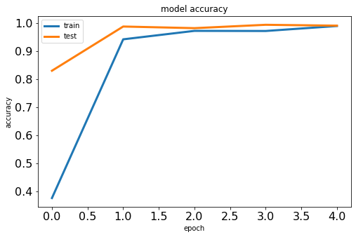
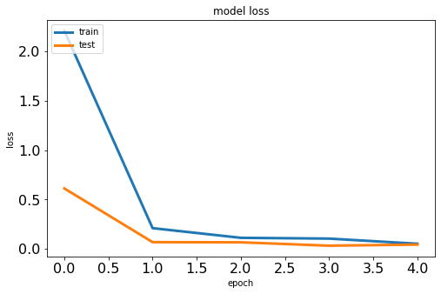
Transfering learnings
DenseNet121 (See Figure 3)
Accuracy and Loss(Categorical Cross-Entropy)

Slide 13
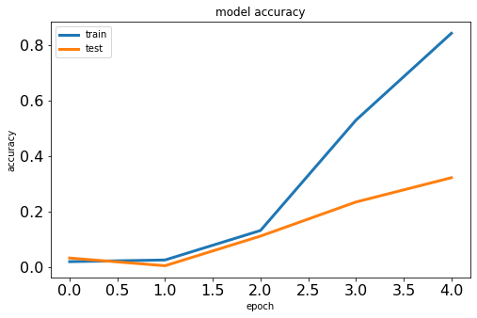
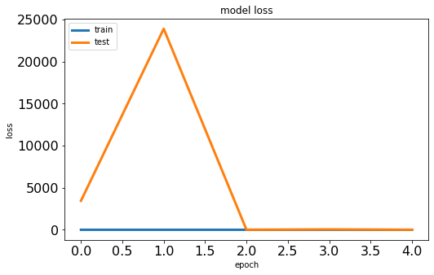
Transfering learnings
2. InceptionNet
Accuracy and Loss(Categorical Cross-Entropy)

Slide 14
Performance Evaluations
Model Name | Train Accuracy | Test Accuracy
Simple CNN(Underfit) | 2.6% | 1.8%(Very bad)
Modified CNN | 82.75% | 80.25%
DenseNet121(Best) | ~99% | ~99%
InceptionNet | 84% | 32%(Overfit)

Slide 15
Future Works
Further Preprocessing
Conversion to GrayScale??
Gaussian Filter to remove noise.
Label “0” handling?
Proper Metrics - F1 score, Precision and Accuracy.
Integrate API for prediction.
Docker integration for reproducibility.

